Slide 1
Virtual Machines
A virtual machine (VM) is a virtual environment which functions as a virtual computer system with its own CPU, memory, network interface, and storage, created on a physical hardware system.
VMs are isolated from the rest of the system, and multiple VMs can exist on a single piece of hardware, like a server.
That means, it as a simulated image of application software and operating system which is executed on a host computer or a server.
It has its own operating system and software that will facilitate the resources to virtual computers.

Slide 2
Characteristics of virtual machines
Multiple OS systems use the same hardware and partition resources between virtual computers.
Separate Security and configuration identity.
Ability to move the virtual computers between the physical host computers as holistically integrated files.

Slide 3
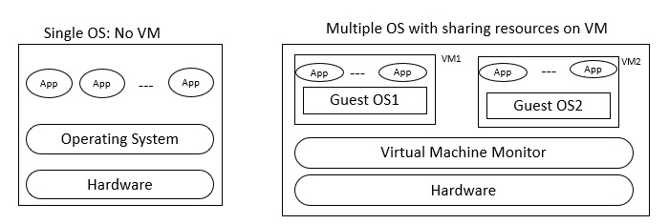
The below diagram shows you the difference between the single OS with no VM and Multiple OS with VM −

Slide 4
Benefits
There is no need of new resources to use different operating system
No risk of any issues with your primary OS
Testing any application on different operating system

Slide 5
Hypervisor
A hypervisor, also known as a virtual machine monitor or VMM, is software that creates and runs virtual machines (VMs).
A hypervisor allows one host computer to support multiple guest VMs by virtually sharing its resources, such as memory and processing.

Slide 6
Why use a hypervisor?
Hypervisors make it possible to use more of a system’s available resources and provide greater IT mobility since the guest VMs are independent of the host hardware.
This means they can be easily moved between different servers.
Because multiple virtual machines can run off of one physical server with a hypervisor, a hypervisor reduces:
Space
Energy
Maintenance requirements

Slide 7
How hypervisor works?
Virtual box share hardware resources from host OS
Separate set of virtual CPU, RAM, Storage
Virtual machines are fully isolated(independent of hosted OS)

Slide 8
Types of Hypervisor
There are two main hypervisor types, referred to as “Type 1” (or “bare metal”) and “Type 2” (or “hosted”).
A type 1 hypervisor acts like a lightweight operating system and runs directly on the host’s hardware, while a type 2 hypervisor runs as a software layer on an operating system, like other computer programs.

Slide 9
Type1(Bare metal)
The most commonly deployed type of hypervisor is the type 1 or bare-metal hypervisor, where virtualization software is installed directly on the hardware where the operating system is normally installed.
Because bare-metal hypervisors are isolated from the attack-prone operating system, they are extremely secure.
In addition, they generally perform better and more efficiently than hosted hypervisors.
For these reasons, most enterprise companies choose bare-metal hypervisors for data center computing needs.
Eg. VMWare, vSphere, Citrix Xen Server

Slide 10
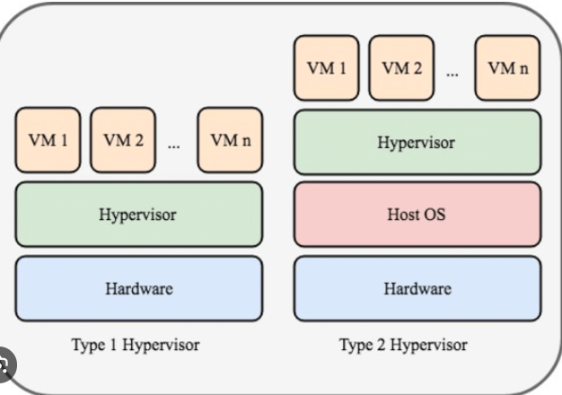



Slide 11
Type2
Hosted hypervisors run on top of the operating system (OS) of the host machine.
Although hosted hypervisors run within the OS, additional (and different) operating systems can be installed on top of the hypervisor.
The downside of hosted hypervisors is that latency is higher than bare-metal hypervisors.
This is because communication between the hardware and the hypervisor must pass through the extra layer of the OS.
Hosted hypervisors are sometimes known as client hypervisors because they are most often used with end users and software testing, where higher latency is less of a concern.

Slide 12
Why do companies use virtualization?
Cheap
Reduces
Workload
Space
Energy
Easy backup using snapshot
Easy recovery

